Slide 1
Object detection in medical imaging
Applying Deep Learning to Mammograms to Classify and Detect Tumors in Breast Tissue

Slide 2
Deep learning in medicine
Reviewing, identifying, and then diagnosing cancerous regions found in mammograms consumes valuable time by multiple medical specialists
Reading and examining the image
Identifying the presence of a tumor
Performing a biopsy to determine the nature of the tumor (malignant or benign)
Deep Learning methods have been shown to provide similar or higher levels of accuracy in performing medical diagnosis from imagery as a trained specialist
With lower ongoing costs (time, personnel resources, etc.), finding a DL model that can accurately detect and classify tumors in mammograms could help lower costs and free up medical professionals to spend time on other pressing issues that machine learning can’t, or hasn’t yet, helped solve.

Slide 3
Deep learning and transfer learning have pushed the boundaries of image detection in the medical field by leaps and bounds
The application of these models can allow physicians to detect and/or help automate the detection of cancerous tissue that might otherwise go undiagnosed upon first inspection by a human technician or other medical professional
Some cancerous tissue is difficult to observe and correctly diagnose without further medical procedure and current classification methods can be improved upon
Some cancers may be easier to detect by looking for subtle differences between healthy and unhealthy tissue in images by using machine learning.
It is rare to find sufficient images to fully train a DL object detection model from scratch, so the best approach is to apply transfer learning
Take weights from pre-trained models on ImageNet or COCO datasets
Using medical images, fine-tune the final weights
This reduces time complexity and allows for sophisticated detection models using the limited number of medical images available to the public

Slide 4
Related work
A paper written using a dataset of colorectal cancer images uses a VGG19 model pre-trained on the ImageNet database and applies transfer learning to images of colorectal cancer.
They discuss methodology and results, along with how their classification results compared to standard medical classification methods.
Another paper that will be useful describes a variety of CNNs trained and tested on the Pascal VOC dataset.
One important paper on the use of the breast cancer images data set will provide valuable information about different approaches to modeling, data processing, and prediction.

Slide 5
data
As a result of privacy laws, a lot of medical data is kept closed to the public and unavailable open source
One of the best open source mammogram datasets available is the CBIS DDSM dataset from The Cancer Imaging Archive
Included are approximately 2000 training and 500 test imagines
There images are relatively balanced with an approximately 50/50 split between malignant (cancerous) and benign images
Each image has a corresponding mask and ROI image

Slide 6
Initial process
There are two main objectives in applying DL to medical imagery
Detection – identifying the specific region of interest (i.e. tumor, blood clot, etc.)
Classification – determining the medical classification of the object being identified (i.e. benign vs. malignant tumor)
As an initial approach, we decided to focus solely on classification to determine whether or not DL models could sufficiently determine the nature of a tumor found in medical images

Slide 7
Mlaas benchmark
Machine learning as-a-service (MLaaS) has grown in popularity with major offerings from Microsoft, Amazon, and others
MLaaS provides cheap, user-friendly solutions for basic machine learning tasks
It is often easier and cheaper to pay for pre-packaged ML services than to build and maintain in-house solutions
For our purposes, it can help benchmark our project and see what benefit building a custom model has over using MLaaS products.

Slide 8
Microsoft AZURE Custom Vision
The best approach we thought was to train a Microsoft Custom Vision classification model on a subset of the COCO images dataset (approximately 12,000 images)
Given the nature of tumors, we chose a subset of the COCO images that best mimic the general shape and structure of a tumor – small, round objects
As seen below, the Custom Vision model performed decently on the COCO images considering the low image count, but performance dropped off considerably on the mammogram dataset
COCO performance was dragged down slightly by the poor performance on a couple of classes that had lower image counts
Mammograms images were balanced between benign and malignant classes
COCO Subset Performance
Mammogram Subset
 | Precision | Recall | F1 | Image Count
Macro Avg | 74.6% | 70.5% | 72.1% | 5581
Weighted Avg | 80.8% | 81.6% | 80.9% | 5581
 | Precision | Recall | F1 | Image Count
Macro Avg | 58.2% | 40.2% | 36.8% | 704
Weighted Avg | 53.7% | 49.4% | 45.1% | 704

Slide 9
Data processing - Classification
Data was manually downloaded as a .tcia file and then extracted to DICOM files
Images were converted into PNG format to allow for easy ingestion
Using the cv2 library, images were read in as 3-channel arrays and resized from approximately 2000 x 5000 to 500 x 1000 to reduce computation time and complexity
Labels were encoded as a binary

Slide 10
Vanilla CNN Classification
A very simply CNN model was created from scratch, simply to gain an idea of the level of classification accuracy that can be accomplished simply and without applying transfer learning
The model architecture was
4 pairs of convolution + max pooling layers
2 dense and dropout layer using a ReLu activation and 0.3 dropout rate, followed by a final dense layer using a sigmoid activation to make the final classification prediction
The model was run on both on the original dataset and an augmented dataset using horizontal flips and rotation to try to prevent overfitting
Selected parameters were
30 training epochs
Batch size of 30 for training, 20 for validation
Learning rate of .0001
Binary cross-entropy loss function

Slide 11
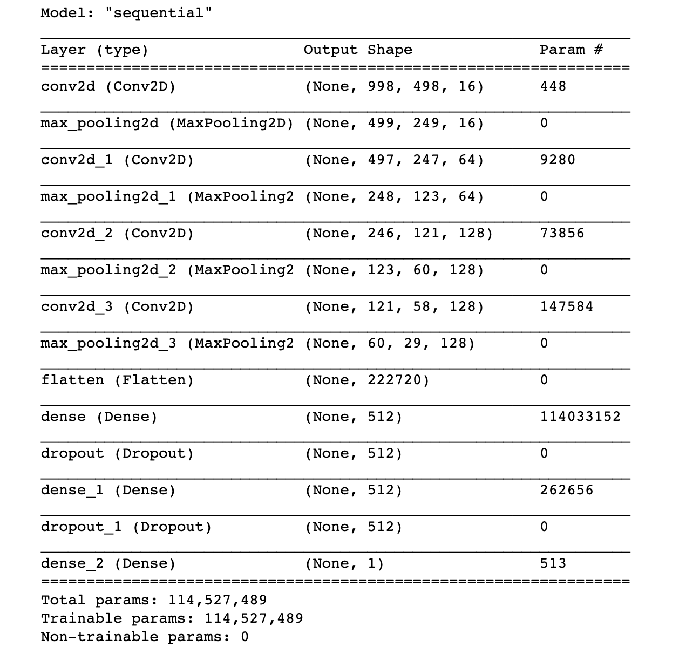
Vanilla CNN Architecture

Slide 12
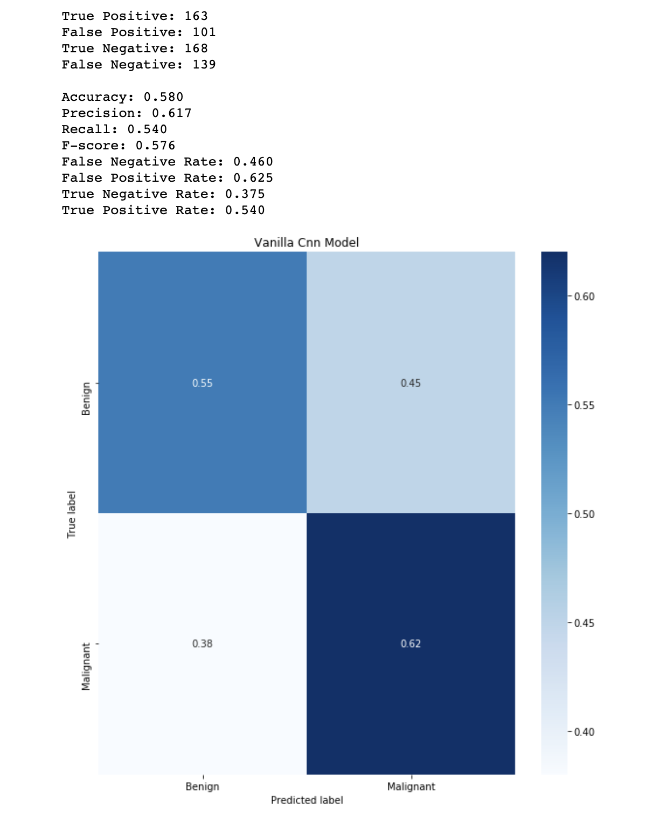
Results
Using non-augmented data, the model quickly overfit the training data
After approximately 10 epochs, the CNN run on the non-augmented dataset reached near perfect training accuracy but validation accuracy fluctuated around 50% for all epochs
Loss decreased to near zero for the training data, but rose for validation until it reached ~2.0 by epoch 15
The augmented dataset provided more volatile results
Both training and validation accuracy fluctuated between 45%-60%, with no clear improvements over time
Accuracy is not as important as having a high true-positive rate (recall) and low false-negative rate (1-recall)
It is more important to make sure malignant cancer gets correctly diagnosed
If the presence of malignant tumors in 1000 mammograms is only 5%, a model predicting all patients were cancer-free would be 95% accuracy but would fail to provide any meaningful level of prediction

Slide 13
Transfer Learning
It is rare to find sufficient images to fully train an object detection model from scratch, so the best approach is to apply transfer learning
Take weights from pre-trained models on ImageNet or COCO datasets
Using our data, fine-tune the final weights
This reduces time complexity and allows for sophisticated detection models using the limited number of medical images available to the public
We used 3 pre-trained CNN models to use as our basis for transfer learning
VGG19
ResNet
Inception

Slide 14
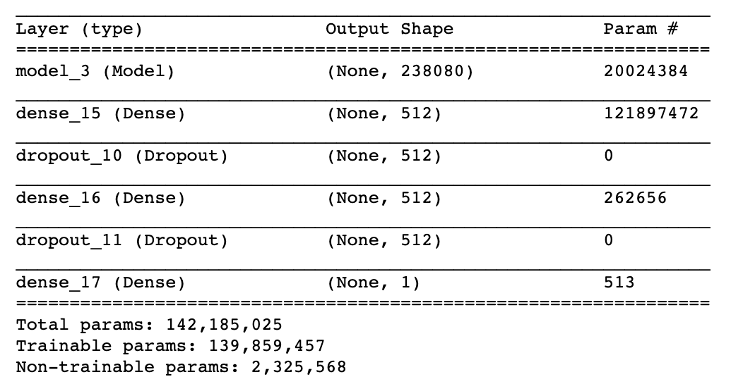
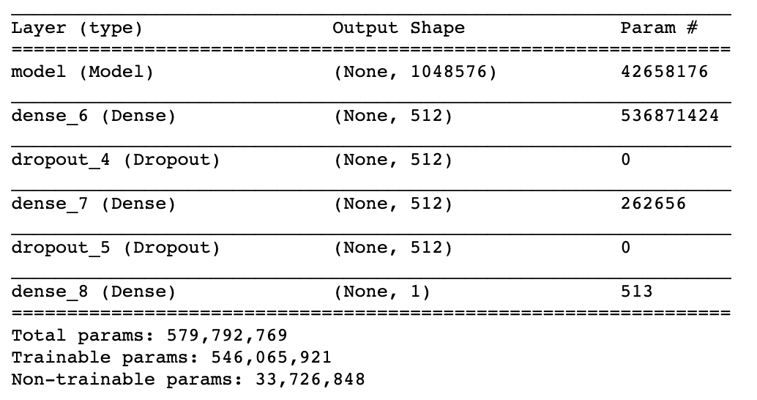
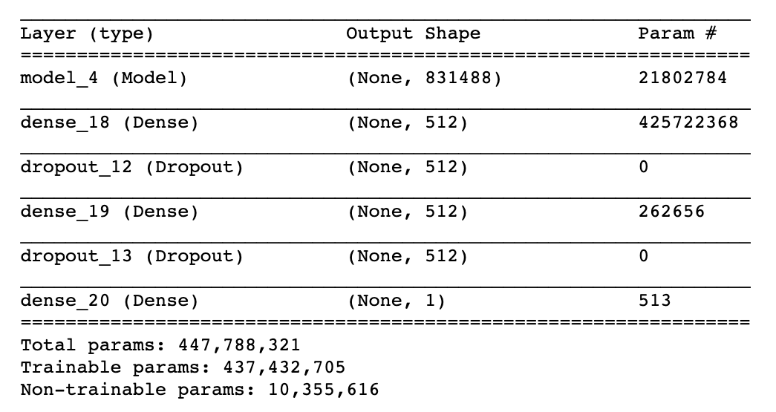
Architecture
VGG19
ResNet
Inception
All models had their upper layers frozen, allowing us to train the lower layers in order to fine-tune the weights to our images
VGG19 weights frozen up to the 3rd convolution block
ResNet weights frozen up to the 5th convolution block
Imagenet weights frozen up to the 83rd convolution layer
The initial layer of each model above is the pre-trained model, and the dense and dropout layers were added to try and reduce overfitting and then force a single classification in the last dense layer

Slide 15
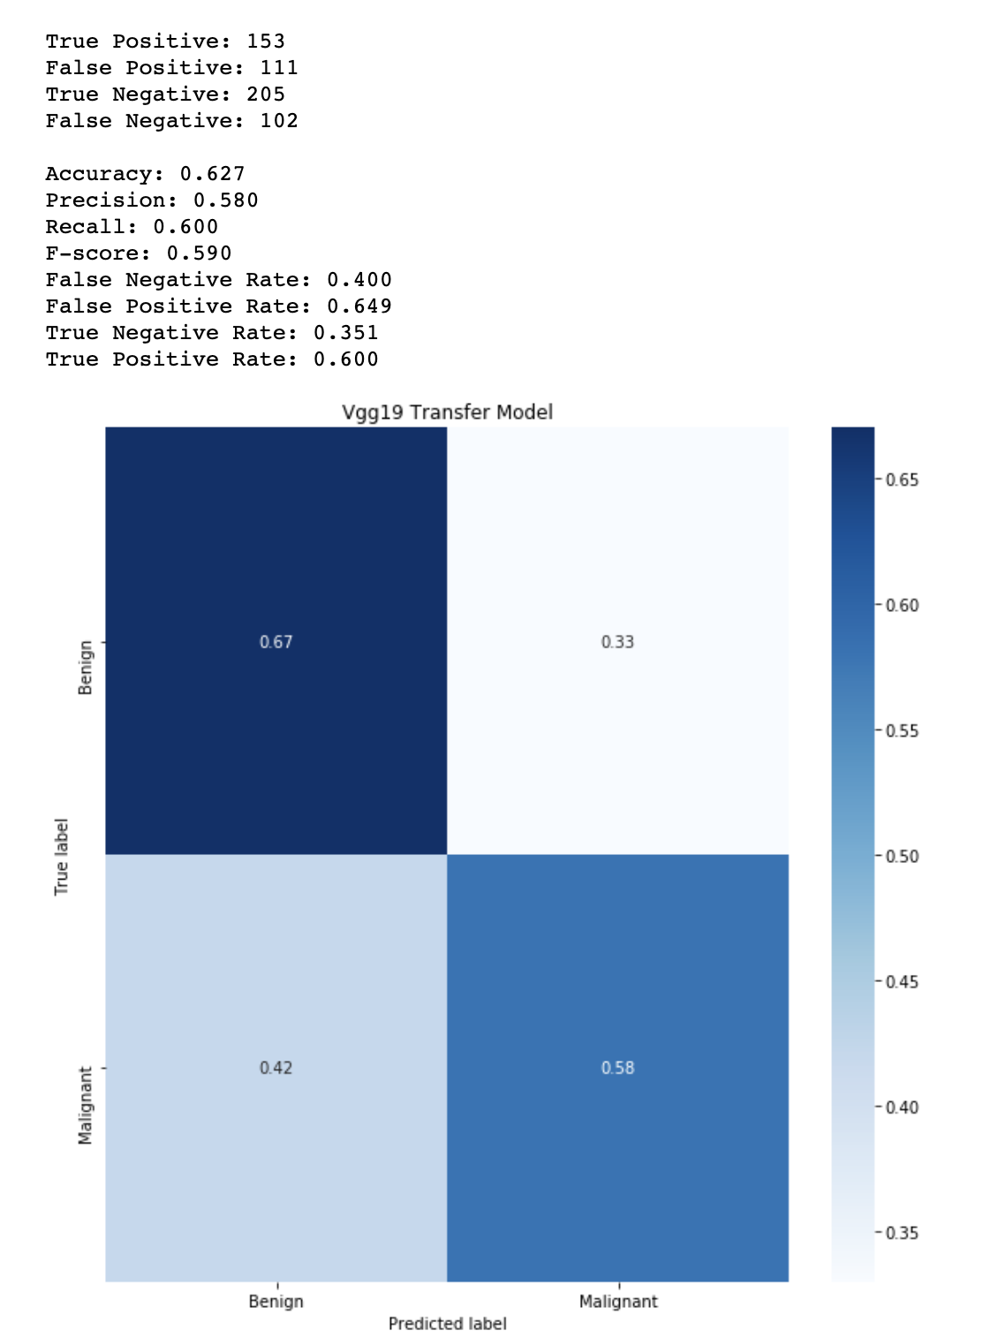
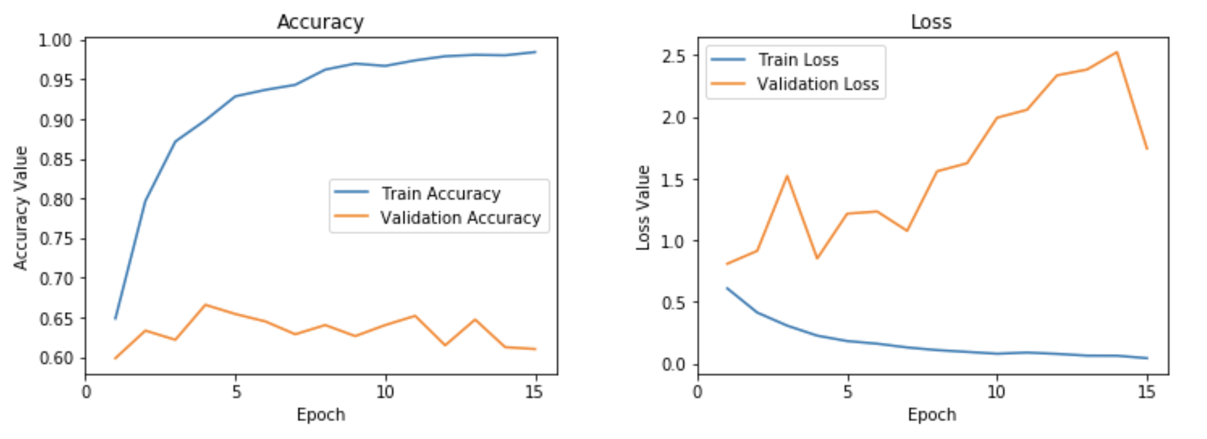
vgg19
VGG19 transfer learning saw similar performance to the vanilla CNN in accuracy and loss
We saw a slight improvement in both true positive and false negative rate, but overall model performance was still poor and little better than random chance on a balanced dataset

Slide 16
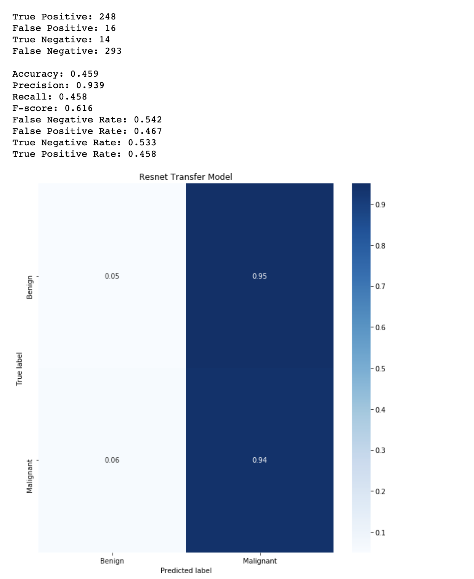
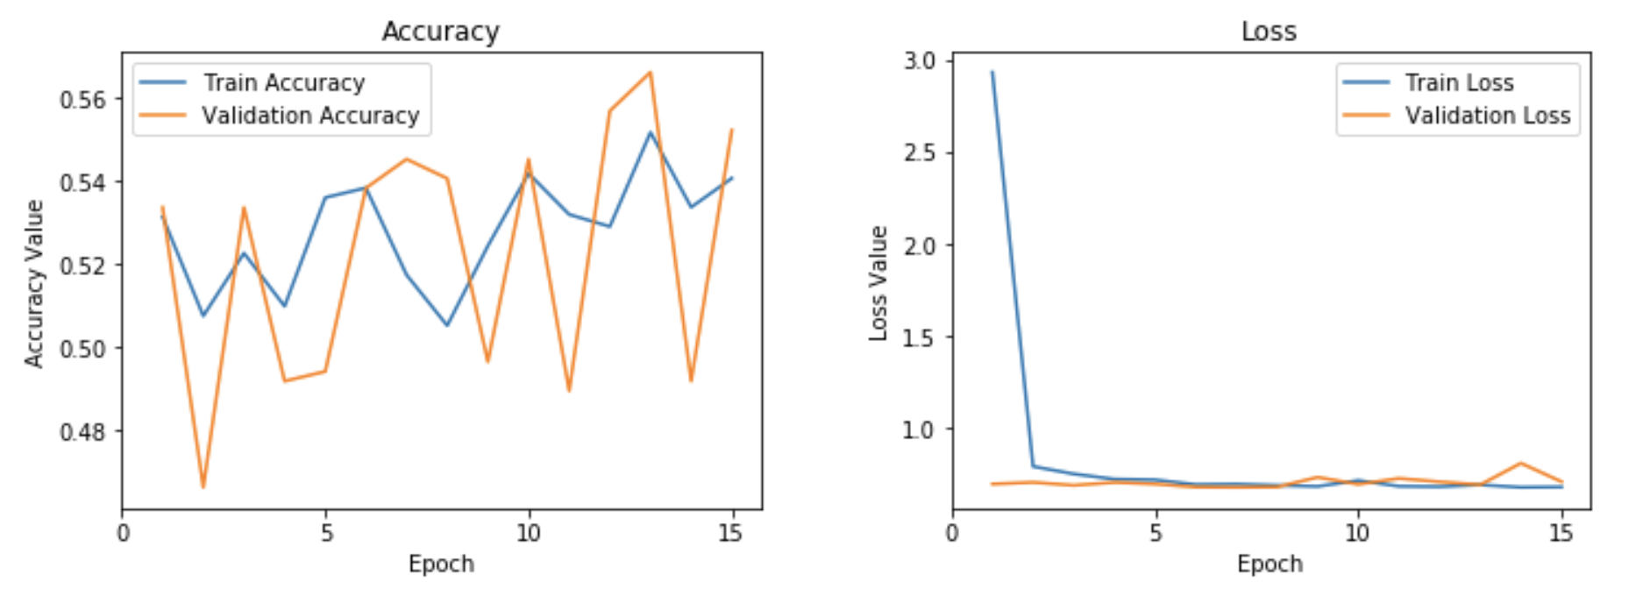
Resnet
ResNet saw a reduction in overfitting, and validation loss was extremely low, but the accuracy of the model was little better than random chance
TPR and FPR were worse for ResNet than for VGG19 and the vanilla CNN

Slide 17
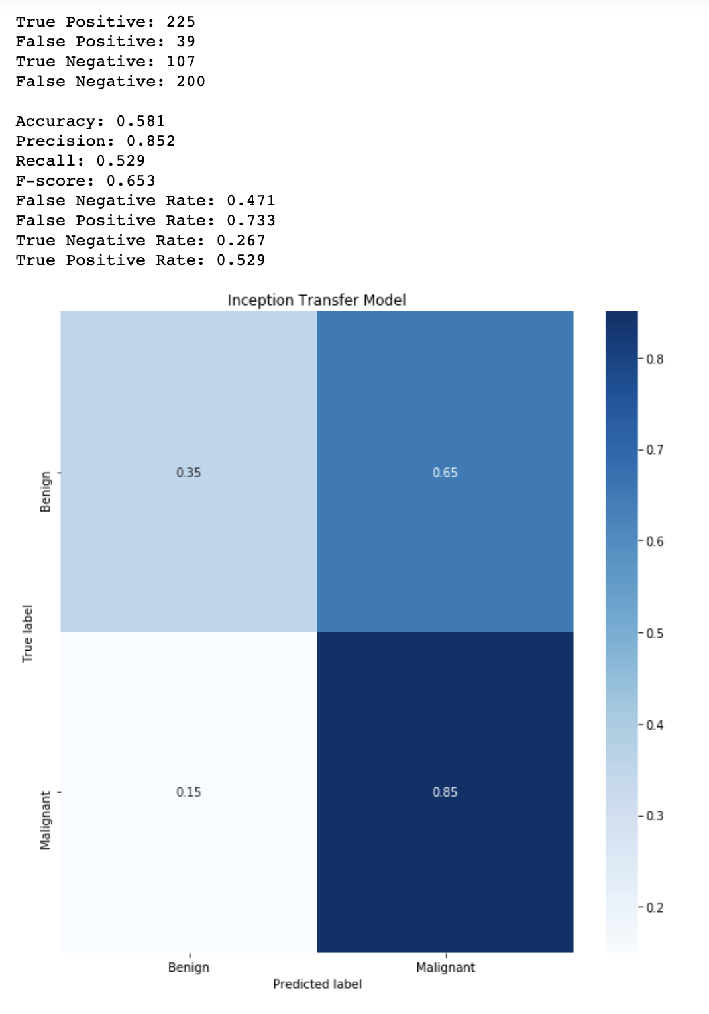
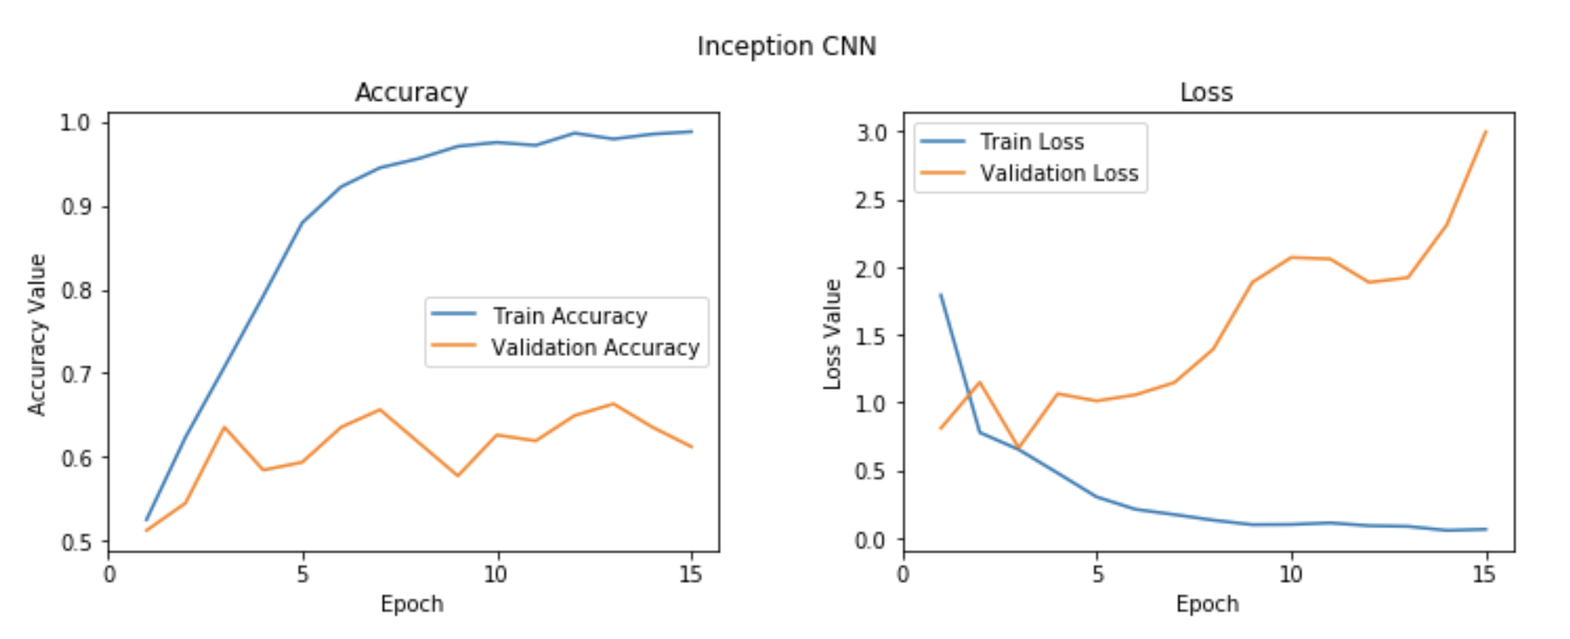
inception
Inception’s performance closely mirrored the vanilla CNN and VGG19 models
It easily overfit the training data and hovered around 60% accuracy in the validation data
TPR and FPR were effectively the same as the vanilla CNN and slightly worse than VGG19

Slide 18
Object detection (should we try mask-rcnn for segmentation since the cbis ddsm images have masks associated with them?????)
The goal of object detection is to be able to identify the specific pixel region of a photograph and classify this segment
In training these models, photos are supplied with their classification and a boundary box, which determines the region in which the object exists in the photo
Image segmentation tries to outline the specific object, whereas detection simply draws the smallest possible rectangle around the object
Model complexity significantly increases when performing detection, as it introduces a regression problem alongside classification
In mammograms, detection of a tumor is better than simple classification as we want to know exactly where the tumor is, its size, shape, etc. to better inform treatment procedures

Slide 19
Object detection
One of the best source of object detection models is TensorFlow Models (available open-source in GitHub)
Models available for detection are:
CenterNet
EfficientDet
SSD
Mask RCNN
Faster RCNN
Available models were trained on different datasets (ImageNet, COCO, etc.) and using different base RCNNs (Inception, ResNet, etc.)
Models with their final layer weights are supplied, along with the necessary files to support training for transfer learning and evaluation
Faster RCNN using Inception, trained on ImageNet, was chosen as the ideal model
Accuracy is the most important factor in medical image detection
Speed in training is not especially important, and evaluation time for a single image would still be significantly shorter than the process of having a medical professional examine the image

Slide 20
Data Processing - Detection
Due to computational memory constraints, images were compressed to allow for adequate batch sizes without overloading the system’s memory
After multiple iterations, images were eventually reduced to 10x40
Bounding boxes were created using the mask images provided by determining the edges of the masks in each image and taking the x,y coordinates
To meet the TensorFlow model criteria, a .tfrecord file was created containing all of the training and test data, with each image, its boundary box coordinates, and class label.
.pbtext files were also created, mapping the class name to the binary label created

Slide 21
DEPLOYMENT
The TF Models files, model configuration, and data were manually uploaded to Paperspace using a TensorFlow 2.0 with GPU support container
The necessary dependencies and local files needed to be installed were done in a notebook
The model training was done in a terminal command in the GPU instance

Slide 22
ROADBLOCKS IN DEPLOYMENT
After a first try, it turns out that installing the necessary dependencies specific to the TF Models repo inside the container disables the GPU support, even with extensive debugging and investigation to try and regain GPU support
The internal TF Models files were significantly modified to avoid this problem, preventing fast, easy deployment
Various GPU configurations were used to try and train the model once the initial problem was resolved
P100, GV100, and GV100x8
In all instances, the model configuration had to be reduced to 2-4 batch size to prevent memory errors, and I was unable to modify the object detection code to enable multi-GPU support
After extensive effort and financial investment, we switched to using Google Colab and a TPU runtime
In the future, it would be necessary to extensively modify the code for distributed training, or to run it on a local setup to avoid the constraints and memory limitations of the Paperspace and Colab instances

Slide 23
Second training
Google Colab using a TPU was chosen
The highest batch size we could use without running into memory constraints was 8 (on TPU, GPU memory constraints led to even lower batch size)
The model was run on 40,000 training steps, at a time of ~15s per step
Detection results on the test set was far from ideal
Model chosen has a 39.85 MAP on COCO images
Average recall at IoU 0.5 was less than 0.001, and average precision was 0.003
Extensive fine-tuning was done on the mammograms, but
Images has to be down-sized significantly due to memory constrains
Batch size also had to be significantly reduced
These factors, along with limited access to computing resources, likely restricted performance of the model

Slide 24
Lessons learned
Other authors and machine learning engineers have demonstrated the power of object detection in medical imaging, including mammography
Lack of easily-accessible computational resources severely limited the scope of the project
Given sufficient resources, the following could allow for better results
Original image sizing
Larger batch sizes
More extended training time
Image augmentation (cropping, flipping, etc.)
A further extension of the project would be to use the image masks for object segmentation
If model performance is sufficiently high, this would make tumor detection and classification even more helpful than simple bounding box detection and classification

